Slide 1
Basic Algorithm : Searching & Sorting
TOPIC 2
-Roslan Sadjirin

Slide 2
Lesson Outcomes
At the end of the lesson, student should be able to:
Understand and describe the basic algorithm of Bubble Sort, Insertion Sort, and Binary Search.

Slide 3
Basic Algorithm (Sorting & Searching)
Sorting:
Sorting is the process of arranging a group of items into a defined order, either ascending or descending, based on the criterion.
The task of putting a collection/list in increasing order (or sometimes in decreasing order)
Sorting is considered a classic area of study in computer science.
E.g. Bubble Sort, Insertion Sort, Selection Sort, Quicksort, Mergesort, Heapsort, Radix Sort, Special-Purpose Sort.

Slide 4
Bubble Sort Algorithm (aka Sinking Sort) - Characteristics
Characteristics:
Slow, but it’s conceptually the simplest sorting algorithms.
Uses two nested loops
Sort a list by repeatedly comparing neighboring elements and swapping them if necessary - so that the list will be in order.

Slide 5
Bubble Sort Algorithm (aka Sinking Sort) – Characteristics, cont.
Makes several passes through the list.
On each pass, successive neighboring pairs are compared.
If a pair is in decreasing order, its values are swapped; otherwise, the values remain unchanged.
It’s called bubble sort or sinking sort, because the smaller values gradually “bubble” their way to the top and the larger values sink to the bottom of the list.

Slide 6
Bubble Sort Algorithm (aka Sinking Sort) – Strategy
Strategy:
Scan through the list comparing adjacent elements, and exchange (swap) them if they are not in relative order.
After the 1st pass, the last element becomes the largest in the list.
Then, scan through the list again, bubbling up the second-to-last value.
After the 2nd pass, the second-to-last element becomes the second largest in the list.
This process continues until all elements have been bubbled into their correct positions.

Slide 7
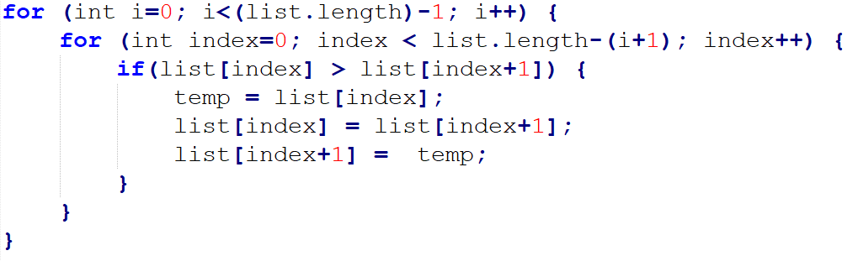
Bubble Sort Algorithm (aka Sinking Sort) – Java Implementation

Slide 8
Bubble Sort Algorithm (aka Sinking Sort) – Example
1st pass (length = 6):
Index (i) | [0] | [1] | [2] | [3] | [4] | [5]
Before 1st pass | 2 | 9 | 5 | 4 | 8 | 1
Step 1
2
3
4
5
After step-n

Slide 9
Bubble Sort Algorithm (aka Sinking Sort) – Example
1st pass (length = 6):
Index (i) | [0] | [1] | [2] | [3] | [4] | [5]
Before 1st pass | 2 | 9 | 5 | 4 | 8 | 1
Step 1 | 2 | 9 | 5 | 4 | 8 | 1
2
3
4
5
After step-n | 2 | 9 | 5 | 4 | 8 | 1

Slide 10
Bubble Sort Algorithm (aka Sinking Sort) – Example
1st pass (length = 6):
Index (i) | [0] | [1] | [2] | [3] | [4] | [5]
Before 1st pass | 2 | 9 | 5 | 4 | 8 | 1
Step 1
2 | 2 | 9 | 5 | 4 | 8 | 1
3
4
5
After step-n | 2 | 5 | 9 | 4 | 8 | 1

Slide 11
Bubble Sort Algorithm (aka Sinking Sort) – Example
1st pass (length = 6):
Index (i) | [0] | [1] | [2] | [3] | [4] | [5]
Before 1st pass | 2 | 9 | 5 | 4 | 8 | 1
Step 1
2
3 | 2 | 5 | 9 | 4 | 8 | 1
4
5
After step-n | 2 | 5 | 4 | 9 | 8 | 1

Slide 12
Bubble Sort Algorithm (aka Sinking Sort) – Example
1st pass (length = 6):
Index (i) | [0] | [1] | [2] | [3] | [4] | [5]
Before 1st pass | 2 | 9 | 5 | 4 | 8 | 1
Step 1
2
3
4 | 2 | 5 | 4 | 9 | 8 | 1
5
After step-n | 2 | 5 | 4 | 8 | 9 | 1

Slide 13
Bubble Sort Algorithm (aka Sinking Sort) – Example
1st pass (length = 6):
Index (i) | [0] | [1] | [2] | [3] | [4] | [5]
Before 1st pass | 2 | 9 | 5 | 4 | 8 | 1
Step 1
2
3
4
5 | 2 | 5 | 4 | 8 | 9 | 1
After step-n | 2 | 5 | 4 | 8 | 1 | 9

Slide 14
Bubble Sort Algorithm (aka Sinking Sort) – Example
2nd pass (length = 6):
Index (i) | [0] | [1] | [2] | [3] | [4] | [5]
Before 2nd pass | 2 | 5 | 4 | 8 | 1 | 9
Step 1
2
3
4
5
After step-n

Slide 15
Bubble Sort Algorithm (aka Sinking Sort) – Example
2nd pass (length = 6):
Index (i) | [0] | [1] | [2] | [3] | [4] | [5]
Before 2nd pass | 2 | 5 | 4 | 8 | 1 | 9
Step 1 | 2 | 5 | 4 | 8 | 1 | 9
2
3
4
5
After step-n | 2 | 5 | 4 | 8 | 1 | 9

Slide 16
Bubble Sort Algorithm (aka Sinking Sort) – Example
2nd pass (length = 6):
Index (i) | [0] | [1] | [2] | [3] | [4] | [5]
Before 2nd pass | 2 | 5 | 4 | 8 | 1 | 9
Step 1
2 | 2 | 5 | 4 | 8 | 1 | 9
3
4
5
After step-n | 2 | 4 | 5 | 8 | 1 | 9

Slide 17
Bubble Sort Algorithm (aka Sinking Sort) – Example
2nd pass (length = 6):
Index (i) | [0] | [1] | [2] | [3] | [4] | [5]
Before 2nd pass | 2 | 5 | 4 | 8 | 1 | 9
Step 1
2
3 | 2 | 4 | 5 | 8 | 1 | 9
4
5
After step-n | 2 | 4 | 5 | 8 | 1 | 9

Slide 18
Bubble Sort Algorithm (aka Sinking Sort) – Example
2nd pass (length = 6):
Index (i) | [0] | [1] | [2] | [3] | [4] | [5]
Before 2nd pass | 2 | 5 | 4 | 8 | 1 | 9
Step 1
2
3
4 | 2 | 4 | 5 | 8 | 1 | 9
5
After step-n | 2 | 4 | 5 | 1 | 8 | 9

Slide 19
Bubble Sort Algorithm (aka Sinking Sort) – Example
3rd pass (length = 6):
Index (i) | [0] | [1] | [2] | [3] | [4] | [5]
Before 3rd pass | 2 | 4 | 5 | 1 | 8 | 9
Step 1
2
3
4
5
After step-n

Slide 20
Bubble Sort Algorithm (aka Sinking Sort) – Example
3rd pass (length = 6):
Index (i) | [0] | [1] | [2] | [3] | [4] | [5]
Before 3rd pass | 2 | 4 | 5 | 1 | 8 | 9
Step 1 | 2 | 4 | 5 | 1 | 8 | 9
2
3
4
5
After step-n | 2 | 4 | 5 | 1 | 8 | 9

Slide 21
Bubble Sort Algorithm (aka Sinking Sort) – Example
3rd pass (length = 6):
Index (i) | [0] | [1] | [2] | [3] | [4] | [5]
Before 3rd pass | 2 | 4 | 5 | 1 | 8 | 9
Step 1
2 | 2 | 4 | 5 | 1 | 8 | 9
3
4
5
After step-n | 2 | 4 | 5 | 1 | 8 | 9

Slide 22
Bubble Sort Algorithm (aka Sinking Sort) – Example
3rd pass (length = 6):
Index (i) | [0] | [1] | [2] | [3] | [4] | [5]
Before 2nd pass | 2 | 4 | 5 | 1 | 8 | 9
Step 1
2
3 | 2 | 4 | 5 | 1 | 8 | 9
4
5
After step-n | 2 | 4 | 1 | 5 | 8 | 9

Slide 23
Bubble Sort Algorithm (aka Sinking Sort) – Example
4th pass (length = 6):
Index (i) | [0] | [1] | [2] | [3] | [4] | [5]
Before 4th pass | 2 | 4 | 1 | 5 | 8 | 9
Step 1
2
3
4
5
After step-n

Slide 24
Bubble Sort Algorithm (aka Sinking Sort) – Example
4th pass (length = 6):
Index (i) | [0] | [1] | [2] | [3] | [4] | [5]
Before 4th pass | 2 | 4 | 1 | 5 | 8 | 9
Step 1 | 2 | 4 | 1 | 5 | 8 | 9
2
3
4
5
After step-n | 2 | 4 | 1 | 5 | 8 | 9

Slide 25
Bubble Sort Algorithm (aka Sinking Sort) – Example
4th pass (length = 6):
Index (i) | [0] | [1] | [2] | [3] | [4] | [5]
Before 4th pass | 2 | 4 | 1 | 5 | 8 | 9
Step 1
2 | 2 | 4 | 1 | 5 | 8 | 9
3
4
5
After step-n | 2 | 1 | 4 | 5 | 8 | 9

Slide 26
Bubble Sort Algorithm (aka Sinking Sort) – Example
5th pass (length = 6):
Index (i) | [0] | [1] | [2] | [3] | [4] | [5]
Before 5th pass | 2 | 1 | 4 | 5 | 8 | 9
Step 1
2
3
4
5
After step-n

Slide 27
Bubble Sort Algorithm (aka Sinking Sort) – Example
5th pass (length = 6):
Index (i) | [0] | [1] | [2] | [3] | [4] | [5]
Before 6th pass | 2 | 1 | 4 | 5 | 8 | 9
Step 1 | 2 | 1 | 4 | 5 | 8 | 9
2
3
4
5
After step-n | 1 | 2 | 4 | 5 | 8 | 9

Slide 28
Bubble Sort Algorithm (aka Sinking Sort)
After the n-1 passes, the list is sorted!
1 | 2 | 4 | 5 | 8 | 9

Slide 29
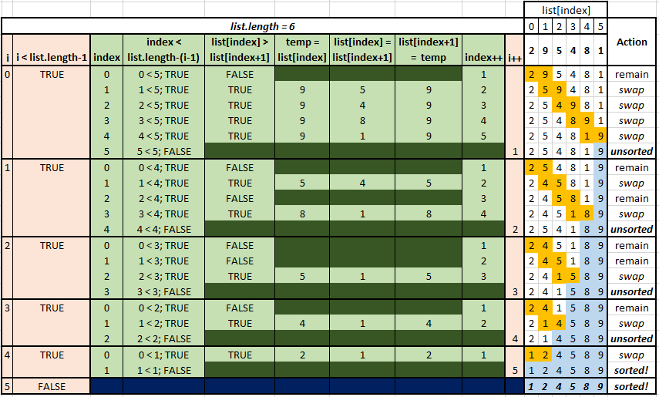
Bubble Sort – Tracing Table

Slide 30
Insertion Sort Algorithm - Characteristics
Characteristics:
About twice as fast as the bubble sort.
Not too complex, although it’s slightly more involved than the bubble sort.
Sort a list of values by repetitively inserting a particular value into a subset of the list that has already been sorted.
One at a time, each unsorted element is inserted at the appropriate position in that sorted subset until the entire list is in order.

Slide 31
Insertion Sort Algorithm – Strategy
Strategy:
Sort the first two values in the list relative to each other by exchanging them if necessary.
Insert the third list value into the position relative to the first two (sorted) values.
Then insert the fourth value into its proper position relative to the first three values in the list.
Each time an insertion is made, the number of values in the sorted subset is increases by one.
Continue this process until all values in the list are completely sorted.
The insertion process requires that the other values in the list shift to make room for the inserted element.

Slide 32
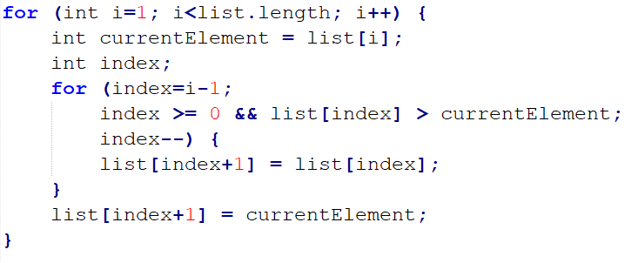
Insertion Sort Algorithm – Java Implementation

Slide 33
Insertion Sort Algorithm – Example
Step 1, list = {2}:
Initially, the sorted sublist contains the first element in the list. Insert 9 into the sublist.
Index (i) | [0] | [1] | [2] | [3] | [4] | [5]
Step (n) | 2 | 9 | 5 | 4 | 8 | 1
1 | 2 | 9 | 5 | 4 | 8 | 1
2
3
4
5
6

Slide 34
Insertion Sort Algorithm – Example
Step 2, list = {2, 9}:
The sorted sublist is {2, 9}. Insert 5 into the sublist.
Index (i) | [0] | [1] | [2] | [3] | [4] | [5]
Step (n) | 2 | 9 | 5 | 4 | 8 | 1
1
2 | 2 | 9 | 5 | 4 | 8 | 1
3
4
5
6

Slide 35
Insertion Sort Algorithm – Example
Step 3, list = {2, 5, 9}:
The sorted sublist is {2, 5, 9}. Insert 4 into the sublist.
Index (i) | [0] | [1] | [2] | [3] | [4] | [5]
Step (n) | 2 | 5 | 9 | 4 | 8 | 1
1
2
3 | 2 | 5 | 9 | 4 | 8 | 1
4
5
6

Slide 36
Insertion Sort Algorithm – Example
Step 4, list = {2, 4, 5, 9}:
The sorted sublist is {2, 4, 5, 9}. Insert 8 into the sublist.
Index (i) | [0] | [1] | [2] | [3] | [4] | [5]
Step (n) | 2 | 4 | 5 | 9 | 8 | 1
1
2
3
4 | 2 | 4 | 5 | 9 | 8 | 1
5
6

Slide 37
Insertion Sort Algorithm – Example
Step 5, list = {2, 4, 5, 8, 9}:
The sorted sublist is {2, 4, 5, 8, 9}. Insert 1 into the sublist.
Index (i) | [0] | [1] | [2] | [3] | [4] | [5]
Step (n) | 2 | 4 | 5 | 8 | 9 | 1
1
2
3
4
5 | 2 | 4 | 5 | 8 | 9 | 1
6

Slide 38
Insertion Sort Algorithm – Example
Step 6, list = {1, 2, 4, 5, 8, 9}:
The entire list is now sorted. List = {1, 2, 4, 5, 8, 9}.
Index (i) | [0] | [1] | [2] | [3] | [4] | [5]
Step (n) | 1 | 2 | 4 | 5 | 8 | 9
1
2
3
4
5
6 | 1 | 2 | 4 | 5 | 8 | 9

Slide 39
Insertion Sort Algorithm – Example
After 6th step, the list is sorted!
1 | 2 | 4 | 5 | 8 | 9

Slide 40
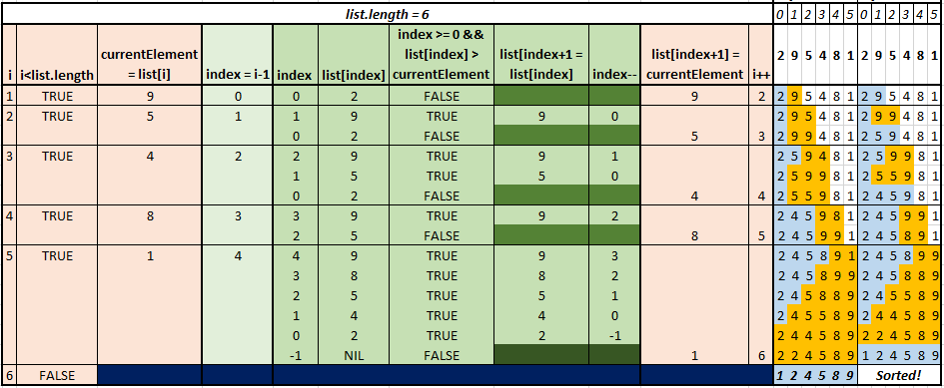
Insertion Sort Algorithm – Tracing Table

Slide 41
Basic Algorithm (Sorting & Searching) –cont.
Searching:
Searching is the process of finding a designated target element within a group of items, or that the target does not exist within the group.
Searching is the task of determining whether a collection/list contains some particular element.
The group of items to be searched is sometimes called the search pool.
E.g. Binary Search, Linear Search, Binary Search Tree, Hashing, Radix Search, External Search, etc.

Slide 42
Binary Search Algorithm
Binary search algorithm is one of the common search approaches for a list of values.
A binary search algorithm eliminates large parts of the search pool with each comparison by capitalizing on the fact that the search pool is in sorted.
For a binary search to work, the elements in the list must already be ordered (sorted).

Slide 43
Binary Search Algorithm – Approach/Strategy
Sort the list (assume list is sorted in ascending order)
Searching for the key begins in the middle of the element/list.
If the key is less than the middle element, search continue in the first half of the list.
Eliminate the second half of the list.
The search continues in the same manner as in the beginning of the search (examining the middle).
If the key is equal to the middle element, the search ends with a match.
If the key is greater than the middle element, search continue in the second half of the list.
Eliminate the first half of the list.
The search continues in the same manner as in the beginning of the search (examining the middle).

Slide 44
Binary Search Algorithm
Each comparison reduces the viable candidates by half until eventually the target element is found or there are no more viable candidates, which means the target element is not in the search pool.

Slide 45
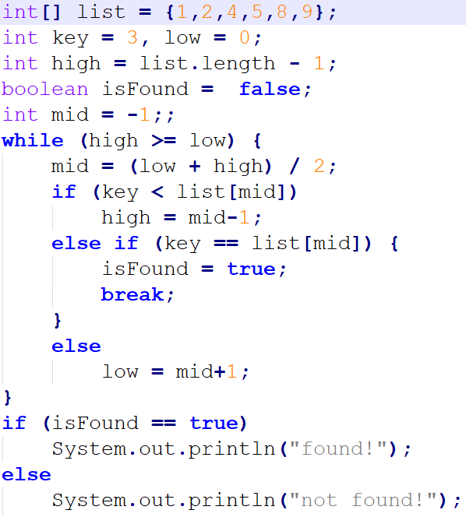
Binary Search Algorithm – Java Implementation I

Slide 46
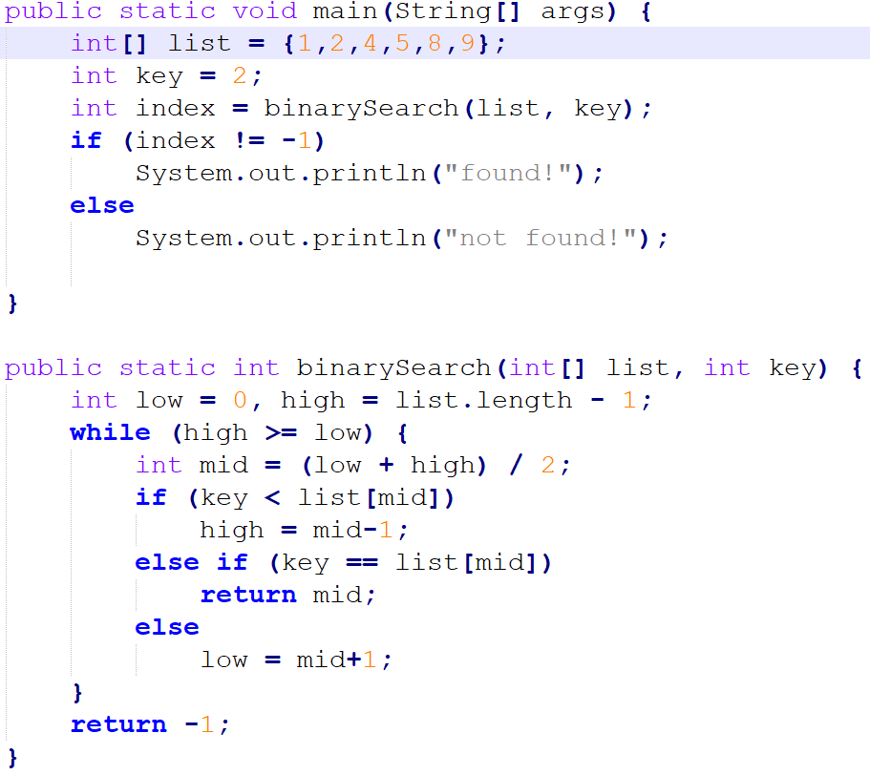
Binary Search Algorithm – Java Implementation II

Slide 47
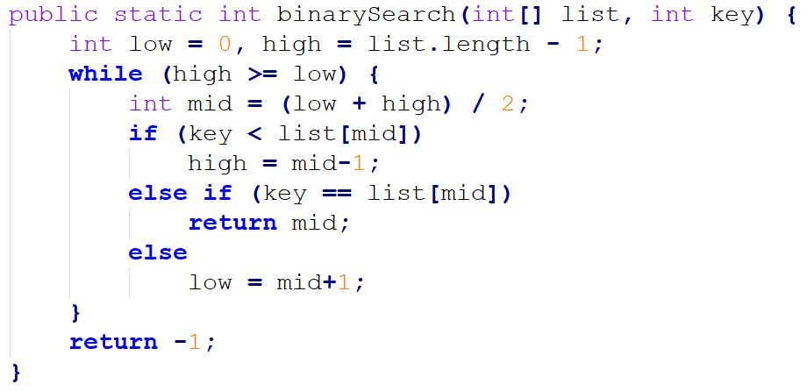
Binary Search Algorithm (Example 1)
✔
1st Round
1st round
Key to be searched: 2
list.length = 6
low = 0
high = 5
mid = (low + high) / 2 🡪 (0 + 5) / 2 = 2
2
[0] | [1] | [2] | [3] | [4] | [5]
1 | 2 | 4 | 5 | 8 | 9
low
mid
high

Slide 48
Binary Search Algorithm (Example 1) – cont.
1st round
Key to be searched: 2
list.length = 6
low = 0
high = 5
mid = 2
2nd round
Key to be searched: 2
list.length = 6
low = 0
high = 1
mid = (low + high) / 2 🡪 (0 + 1) / 2 = 0
✔
2nd Round
2
[0] | [1] | [2] | [3] | [4] | [5]
1 | 2 | 4 | 5 | 8 | 9
low
mid
high

Slide 49
Binary Search Algorithm (Example 1) – cont.
2nd round
Key to be searched: 2
list.length = 6
low = 0
high = 1
mid = 0
3rd round
Key to be searched: 2
list.length = 6
low = 1
high = 1
mid = (low + high) / 2 🡪 (1 + 1) / 2 = 1
✔
Found!
2
[0] | [1] | [2] | [3] | [4] | [5]
1 | 2 | 4 | 5 | 8 | 9
Found!
mid
low
high

Slide 50
Binary Search Algorithm (Example 2)
✔
1st Round
1st round
Key to be searched: 5
list.length = 6
low = 0
high = 5
mid = (low + high) / 2 🡪 (0 + 5) / 2 = 2
5
[0] | [1] | [2] | [3] | [4] | [5]
1 | 2 | 4 | 5 | 8 | 9
low
mid
high

Slide 51
Binary Search Algorithm (Example 2) – cont.
1st round
Key to be searched: 5
list.length = 6
low = 0
high = 5
mid = 2
2nd round
Key to be searched: 5
list.length = 6
low = 3
high = 5
mid = (low + high) / 2 🡪 (3 + 5) / 2 = 4
✔
2nd Round
5
[0] | [1] | [2] | [3] | [4] | [5]
1 | 2 | 4 | 5 | 8 | 9
low
mid
high

Slide 52
Binary Search Algorithm (Example 2) – cont.
2nd round
Key to be searched: 5
list.length = 6
low = 3
high = 5
mid = 4
3rd round
Key to be searched: 5
list.length = 6
low = 3
high = 3
mid = (low + high) / 2 🡪 (3 + 3) / 2 = 3
✔
Found!
5
[0] | [1] | [2] | [3] | [4] | [5]
1 | 2 | 4 | 5 | 8 | 9
Found!
mid
low
high

Slide 53
Binary Search Algorithm (Example 3)
✔
1st Round
1st round
Key to be searched: 7
list.length = 6
low = 0
high = 5
mid = (low + high) / 2 🡪 (0 + 5) / 2 = 2
7
[0] | [1] | [2] | [3] | [4] | [5]
1 | 2 | 4 | 5 | 8 | 9
low
mid
high

Slide 54
Binary Search Algorithm (Example 3) – cont.
1st round
Key to be searched: 7
list.length = 6
low = 0
high = 5
mid = 2
2nd round
Key to be searched: 7
list.length = 6
low = 3
high = 5
mid = (low + high) / 2 🡪 (3 + 5) / 2 = 4
✔
2nd Round
7
[0] | [1] | [2] | [3] | [4] | [5]
1 | 2 | 4 | 5 | 8 | 9
low
mid
high

Slide 55
Binary Search Algorithm (Example 3) – cont.
2nd round
Key to be searched: 7
list.length = 6
low = 3
high = 5
mid = 4
3rd round
Key to be searched: 7
list.length = 6
low = 3
high = 3
mid = (low + high) / 2 🡪 (3 + 3) / 2 = 3
✔
3rd Round
7
[0] | [1] | [2] | [3] | [4] | [5]
1 | 2 | 4 | 5 | 8 | 9
mid
low
high

Slide 56
Binary Search Algorithm (Example 3) – cont.
3rd round
Key to be searched: 7
list.length = 6
low = 3
high = 3
mid = 3
4th round
Key to be searched: 7
list.length = 6
low = 4
high = 3
mid = 3
α
Not Found!
7
[0] | [1] | [2] | [3] | [4] | [5]
1 | 2 | 4 | 5 | 8 | 9
high >= low is
FALSE, then return -1
mid
high
low

